Slide 1
Static Timing Analysis
Sci.D.Professor Vazgen Melikyan
Synopsys Armenia Educational Department

Slide 2
CONFIDENTIAL INFORMATION
The information contained in this presentation is the confidential and proprietary information of Synopsys. You are not permitted to disseminate or use any of the information provided to you in this presentation outside of Synopsys without prior written authorization.
IMPORTANT NOTICE
In the event information in this presentation reflects Synopsys’ future plans, such plans are as of the date of this presentation and are subject to change. Synopsys is not obligated to update this presentation or develop the products with the features and functionality discussed in this presentation. Additionally, Synopsys’ services and products may only be offered and purchased pursuant to an authorized quote and purchase order or a mutually agreed upon written contract with Synopsys.

Slide 3
Course Overview
STA Concepts
1 lecture
Delay Modeling
1 lecture
Interconnect Parasitics
1 lecture
Delay Calculation
1 lecture
Configuring the STA Environment
1 lecture
Timing Checks
1 lecture
Crosstalk and Noise
1 lecture

Slide 4
STA Concepts

Slide 5
Static Timing Analysis (STA)
STA is a technique for digital design verification. It:
Validates if the design can operate at the set timing constraints
Is a complete and exhaustive verification of all timing checks of a design
Is used instead of simulation

Slide 6
Simulation
Simulating (dynamically) circuit response for a specified set of input patterns
Circuit modeled as network of capacitors, resistors and voltage/current sources
0 1 0
0 1 1
Notes:
Fundamentally, timing analysis can be performed dynamically or statically. In dynamic analysis, a circuit is analyzed for a particular time interval by simulating its response for a fully specified set of input patterns. Dynamic analysis can be performed using circuit simulator SPICE, fast circuit simulators, or gate-level simulators. It is the most accurate way of verifying timing and functional characteristics of a circuit is simulation, but for large designs often it can be impossible to do exhaustive analysis in acceptable time.

Slide 7
STA (2)
Vector-less topological analysis of a circuit.
The signal at the input is propagated through the gates at each level till it reaches the output
0
2
4
6
C
O
A
Notes:
Static Timing Analysis (STA) is the effective methodology for verifying the timing characteristics of a design without the use of test vectors because thousands of test vectors are required to test all timing paths using logic simulation.
Key principle behind STA is propagating delays through logic gates by simply summing signal arrive times with delay time of the cell and finding maximum of all available arrive times on a net.
A gate is being processed in STA when the arrival times of all inputs are known, at which time the candidate delay values at the output are computed using SUM operation that adds the delay at each input with input-to-pin delay. Once these candidate delays have been found, the MAX operation is applied to determine the maximum arrival time at the output. The arrival time at the input is propagated through the gates at each level till it reaches the output.

Slide 8
STA vs. Simulation
Simulation
Advantages
Can be very accurate (Spice-level)
Disadvantages
Analysis quality depends on stimulus vectors
Non-exhaustive, slow
Static Timing Analysis (STA)
Advantages
Exhaustive timing coverage
Does not require input vectors
Faster operation
Disadvantages
Less accurate
Must define timing requirements/exceptions
Difficulty in handling asynchronous designs, false paths
Notes:
Though it is high accuracy simulation cannot be used for large design because of slowness and needs to exhaustive vector-set generation. Static timing analysis (STA), in its turn, has a number of vital advantages over dynamic simulation that made it into the industrial workhorse for verifying timing properties of synchronous digital circuits.

Slide 9
Digital Circuits Timing Goals
Achievement of required frequency
Digital circuits are constrained to work under specific frequencies
All separate parts of circuit are constrained to have delay smaller than clock period
Meeting timing constraints
Avoiding collision of signals
Avoiding failure
STA verifies these

Slide 10
Problem Variability
Other variables affect circuit timing, thus need to be considered during design
Operating Conditions
Process, Voltage, Temperature variations
Unstable clock frequency (jitter, skew)
Instability of clock frequency requires design margin
On-chip variation (OCV)
Device/Interconnect

Slide 11



Components of Circuit Timing
Delay components
Cells, Interconnects
Constrained components
Clocked registers require setup/hold, recovery/removal constraints
FF
For circuit to operate without failure it is required that delay components at no point violate constraints of other components.

Slide 12
Cell Timing Parameters
N | Parameter | Unit | Symbol | Figure | Definition
 | Rise transition time | ns | t_{R} |  | The time it takes a driving pin to make a transition from kV_{DD} to (1-k)V_{DD} value. Usually k=0.1 (also possible k=0.2, 0.3, etc)
 | Fall transition time | ns | t_{F} |  | The time it takes a driving pin to make a transition from (1‑k)V_{DD} to kV_{DD} value. Usually k=0.1 (also possible k=0.2, 0.3, etc)
 | Propagation delay low-to-high (rise) | ns | t_{PLH} (t_{PR}) |  | Time difference between the input signal crossing a 0.5V_{DD} and the output signal crossing its 0.5V_{DD} when the output signal is changing from low to high
4. | Propagation delay high-to-low (Fall) | ns | t_{PHL} (t_{PF}) |  | Time difference between the input signal crossing a 0.5V_{DD} and the output signal crossing its 0.5V_{DD} when the output signal is changing from high to low
0.9V
V
DD
DD
0.1V
DD
V
SS
t
R
V
DD
0.9V
DD
0.1V
DD
t
F
V
SS
IN
0.5V
DD
O
UT
0.5V
DD
t
PLH
IN
OUT
0.5V
DD
t
0.5V
DD
PHL

Slide 13
Cell Timing Constraints
Setup/Hold, Recovery/Removal Constraints
N | Parameter | Unit | Symbol | Figure | Definition
1 | Setup time (only for flip-flops or latches) | ns | t_{SU} |  | The minimum period in which the input data to a flip-flop or a latch must be stable before the active edge of the clock occurs
2.. | Hold time (only for flip-flops or latches) | ns | t_{H} |  | The minimum period in which the input data to a flip-flop or a latch must remain stable after the active edge of the clock has occurred
3 | Removal time (only for asynchronous Set or Reset) | ns | t_{REM} |  | The minimum time in which the asynchronous Set or Reset pin to a flip-flop or latch must remain enabled after the active edge of the clock has occurred
4 | Recovery time (only for asynchronous Set or Reset) | ns | t_{REC} |  | The minimum time in which Set or Reset must be held stable after being deasserted before next active edge of the clock occurs
DATA
0.5V
DD
t
SU
CLOCK
0.5V
DD
DATA
0.5V
DD
CLOCK
0.5V
DD
t
H
SET (RESET)
0.5V
DD
CLOCK
0.5V
DD
t
REM
0.5V
DD
SET (RESET)
CLOCK
0.5V
DD
t
REC

Slide 14
Timing Closure Problem
Problem
In clocked environment signals on the register inputs must arrive before next reading sequence
Delay
t_{setup}
Some operations
IN
OUT
IN
OUT
Register
Register
Some data
New data
to store
CLK
CLK
Clock
Clock: Both registers store new value at specific points of time (with some frequency, like 1GHz)
Delay + t_{setup} < T_{clock}

Slide 15
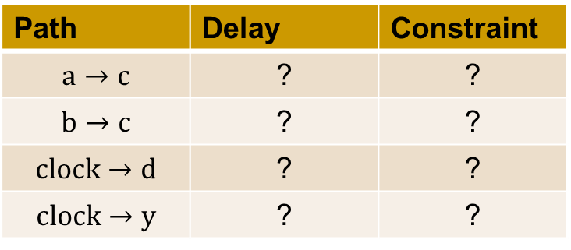
Static Timing Analysis Steps
Circuit is broken into timing paths
d
e
y
a
c
FF
b
FF
clock
Delay of each path is calculated
Path | Delay | Constraint
 | ? | ?
 | ? | ?
 | ? | ?
 | ? | ?
For each path delays are checked against timing constraints

Slide 16
STA Concepts
Timing Path
Required Time
Arrival Time
Slack
Critical Path

Slide 17
Timing Paths
Timing path has a start point and an endpoint.
Start point:
Input ports
Clock pins of flip-flops
Endpoints:
Output ports
data input pins of flip-flops
c
d
e
y
a
FF
FF
b
clock

Slide 18
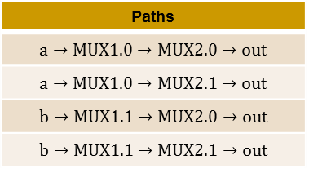
Possible Paths
a
1
1
0
1
0
MUX1
MUX2
out
b
1
1
sel
1
1
sel
c
1
Paths

Slide 19
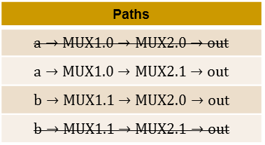
False Paths
Paths which physically exist in a design but are not logic paths. These paths never get sensitized under any input condition
a
1
1
0
1
0
MUX1
MUX2
out
b
1
1
sel
1
1
sel
c
1
Paths

Slide 20
Multi-cycle Paths
There are data paths that require more than one clock period for execution.
2 clock period delay

Slide 21
Required Time
Required time specifies the time point (interval) at which data is required to arrive at end point (data is required to be stable after arrival).
Time point after which data can become unstable (change) is called earliest required time
Time point after which data cannot become unstable (change) is called latest required time
The requirement is set by timing constraints like setup/hold, removal/recovery, etc.
cycle 1
cycle 2
clock
Hold violation will occur here
Setup violation will occur here
earliest
required time
latest
required time

Slide 22
Arrival Time
Arrival time defines the time interval during which a data signal will arrive at a path endpoint (after arrival time signal will be stable).
Data is normally triggered by clock edge
Data arrival depend on circuit delay, which vary (depend on temperature, supply voltage, etc.)
Minimum delay, early arrival
Maximum delay, late arrival
CLOCK
earliest
arrival time
latest
arrival time
Data Signal
min
max

Slide 23
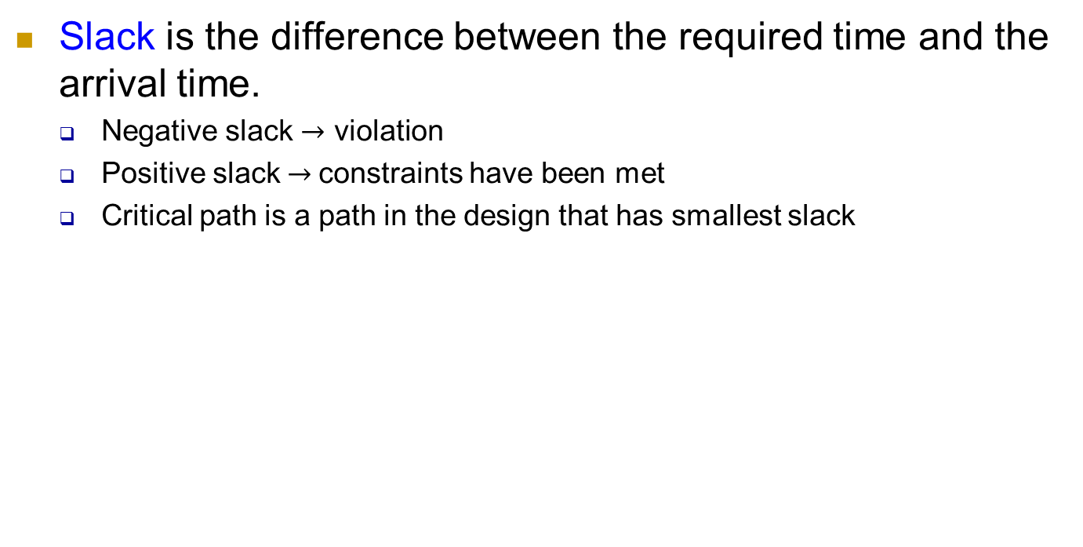
Slack and Critical Path
setup
setup
clock
clock
data
data

Slide 24
Early and Latest Analysis
STA tool calculates the slack of each logic path, in order to find critical path.
Early and Latest analysis approaches:
Assumes circuits have minimum delay, compares arrival time to earliest required time (hold check)
Assumes circuits have maximum delay, compares arrival time to latest required time (setup check)
setup
setup
clock
clock
data
data

Slide 25
Path Groups
Timing paths are grouped into path groups by the clocks controlling their endpoints
Slack is calculated in relation to each clock
clk1
?
path1
a
c
d
e
y
clk2
DEFAULT
b
FF
FF
path2
path3
path4
clock 1
clock 2
Path Groups

